Slide 1



Connecting voice assistants to flow
Vivek Bavishi aka That API Guy

Slide 2





Thanks to our Sponsors!
Silver
Platinum
Gold

Slide 3

More Fun Stuff
Raffle: Please join us in the MPR at 4:45 PM for the raffle. We are raffling some exciting prizes (must be present to win)!!!
SharePint will be held from 5:15-?? at Sharp Edge Bistro (922 Penn Ave… a 4-minute walk). We have the lounge area at the front of the bar reserved. See Sandy for a beer ticket when you arrive!

Slide 4
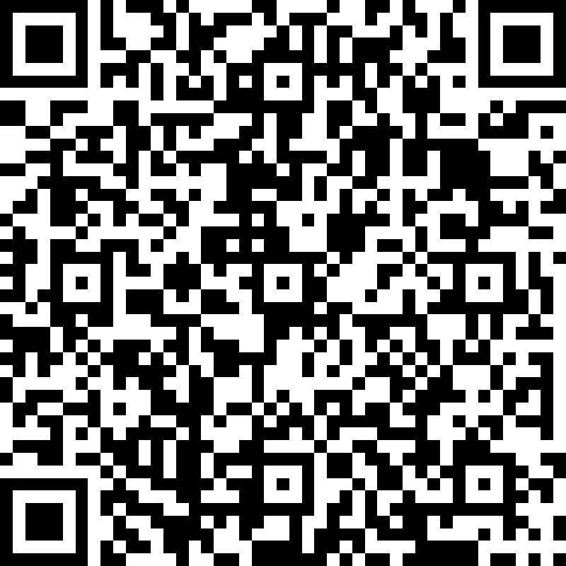
We do Request that…
You fill out the Session & Event evaluation form. Access the form after each session at bit.ly/SPSBurghEval OR scan this QR code (it’s also on the event schedule). Your EVENT eval enters you in the raffle; each SESSION eval gives you another entry!
You visit the sponsors. The event is possible due to their generous support and we request that you visit them and inquire about their products & services.
Cell phones be kept on silent as a courtesy to other attendees and speakers

Slide 5

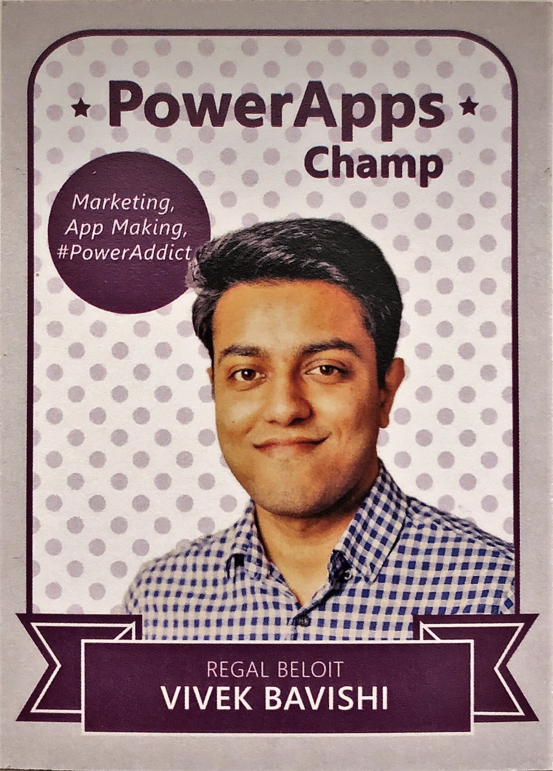



About me
Digital Customer Experience Manager
Cincinnati PowerApps and Flow User Group Leader
Addicted to PowerApps and Flow for past 2 years.
#PowerAddict
@that_API_guy
That API Guy
thatapiguy.tech

Slide 6
Before we Start
Out of all voice assistants, do you use Siri the most?
Out of all voice assistants, do you use Alexa the most?
Have you used Flow before?

Slide 7
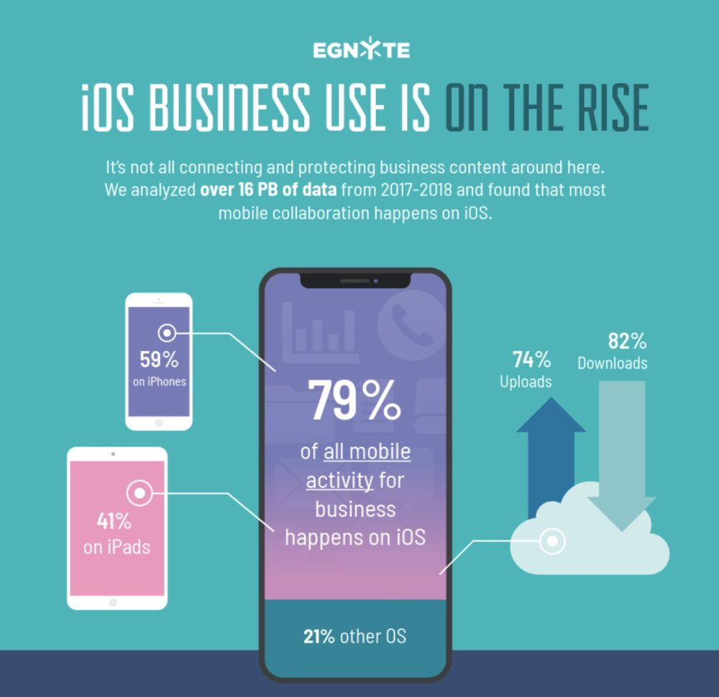
Why Siri?
*Source: 9to5mac.com

Slide 8
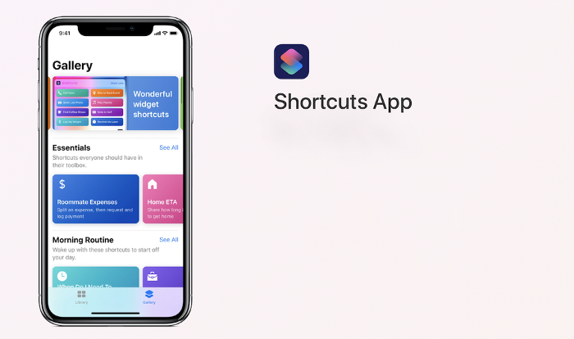
How do we do it?

Slide 9
Different types of SIRI + Flow
Input | Output
No inputs | Trigger Flow + Run action/s
Some input/s | Trigger Flow + Use Input to do something + Run action/s
Some input/s | Trigger Flow + Use Input to do something +Run action and send back response.

Slide 10
Demo time
Set out of office automatic replies.
1
Tweet a message / Follow a hashtag.
2
Upload a photo to SharePoint doc library.
3
List tasks due for today.
4

Slide 11
Other Use cases
CRM opportunities created in the last 7 days.
Update a SharePoint list.
Cancel all meetings for the next day.
Send “Not well” email to manager.

Slide 12

Learning Resources
https://support.apple.com/guide/shortcuts/welcome/ios
https://support.apple.com/guide/shortcuts/request-your-first-api-apd58d46713f/ios

Slide 13

Alexa, How do we do it?
https://thatapiguy.tech/2019/03/11/alexa-ask-microsoft-flow-to-read-out-my-latest-e-mail/

Slide 14
We do Request that…
You fill out the Session & Event evaluation form. Access the form after each session at bit.ly/SPSBurghEval OR scan this QR code (it’s also on the event schedule). Your EVENT eval enters you in the raffle; each SESSION eval gives you another entry!
You visit the sponsors. The event is possible due to their generous support and we request that you visit them and inquire about their products & services.
Cell phones be kept on silent as a courtesy to other attendees and speakers

